Slide 1
PHAS0052: Environmental Analysis of Food Packaging & Labelling for Sustainability
Group 15-B

Slide 2
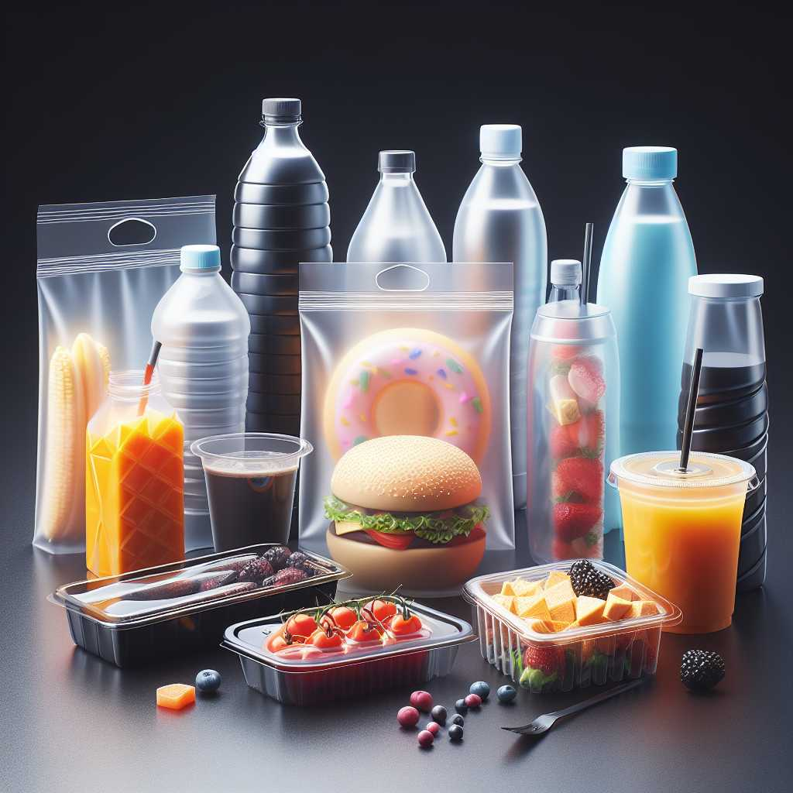
Content Overview
Introduction
An outline of the project: A case study on Tesco meal deal + Theoretical Scoring System
Objectives: Three environmental indicators
Life-cycle assessment and stages of life-cycle
LCA of Plastic Packaging
Extraction of raw materials
Primary production of plastic resins and manufacturing of plastic products
Transportation
Waste Management / End of Life (EOL) processes
LCA of Cardboard (Sandwich box)
Case-study: Results and Findings
Total energy consumption, Crude oil usage and GHGs emissions
Local Scoring System and Aggregated Performance Scoring
Further Improvements
Expanding current recycling processes and waste management routes
Notes:
max

Slide 3
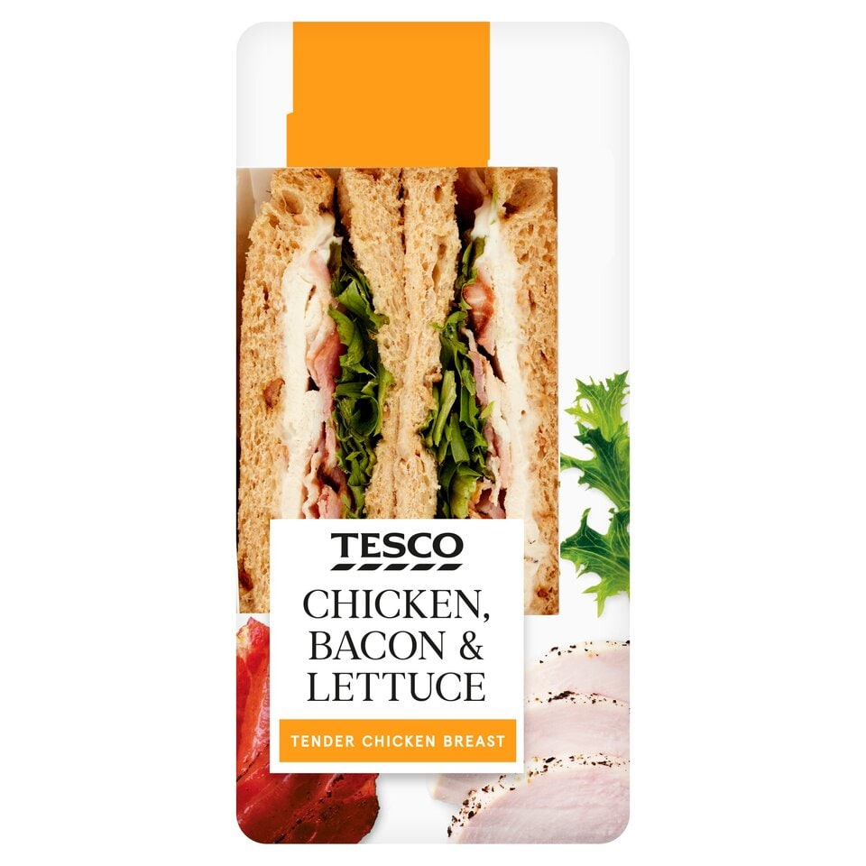
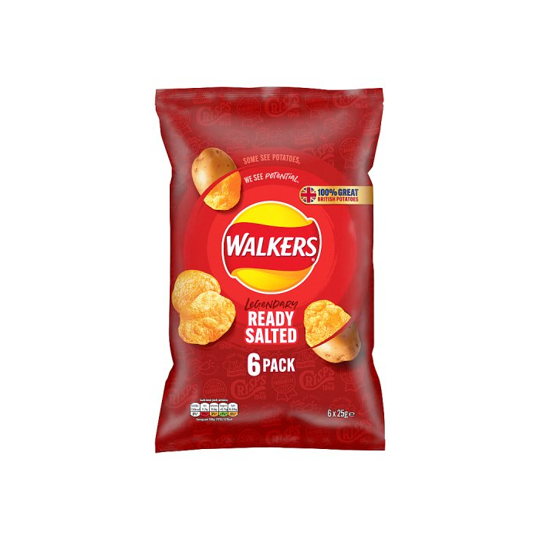
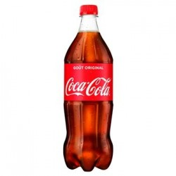
Objectives
We wanted to identify the environmental damage by our everyday consumption habits.
This was achieved by measuring:
CO2e emitted [g] per package
Crude oil used [g] per package
Energy consumed [kJ] per package
Created performance scoring for package
The most popular meal deal across the country consists of a sandwich, packet of crisps and a 500ml bottle of coke
Notes:
The aim of this project was to form a picture of 3 major indicators of the detriment to the environment caused by our every-day consumption habits.
We found the most prominent indicators for food packaging to be:
Mass of CO2e gasses produced to measure emissions
KJ of energy used to measure efficiency
Mass of crude oil consumed to measure resource depletion
We've chosen to deliver our data in grams per package for the first two and KJ per package for the latter as we found this to be the most intuitive.
In an attempt to relate this project back to the idea of every day consumption we have considered the lifecycle of most popular meal deal across the country, from the local Tesco's. This consists of a sandwich, packet of crisps and a 500ml bottle of coke.
We have also given the methodology for computing a performance scoring to make informed-decision about the optimal solution to minimise the environmental impact of a packaging for a specific functional unit.

Slide 4
Life-cycle assessment (LCA)
Extraction Location (North-Sea)
Raw Material Production Site
Definition^{[1]}: a comprehensive method for analysing the environmental impacts associated with products across all stages of their lifecycle.
Five main stages of a product life-cycle (Cradle to Cradle)
Extraction of Petroleum and Natural Gas
Primary Production
Resin production
Polymerisation
Product moulding and processing
Transportation/Distribution
End of life
Plastic Recycling Centre
Plastic Resin Processing facility
Packaging Terminal
Retail (Central London)
Incineration
Landfill
[1] T. Theis, J. Tomkin, Sustainability: A Comprehensive Foundation. 12th Media Services, 2018.
Notes:
In this particular project, in order to evaluate the environmental impact of food packaging or plastic products in general ,the method that we decided to adopt is called the LCA, the life-cycle assessment. This is probably the most widely-used and commonly-used approach in terms of environmental studies, such as quantifying carbon footprints.
By definition:
More specifically, we chose a Cradle to cradle approach which considers every phase of a plastic product from raw material extraction to recycling.
There are five key steps:
the first is…
The last is eol, which includes incineration, recycling, and

Slide 5
Plastic LCA Analysis

Slide 6

01
Extraction

Slide 7
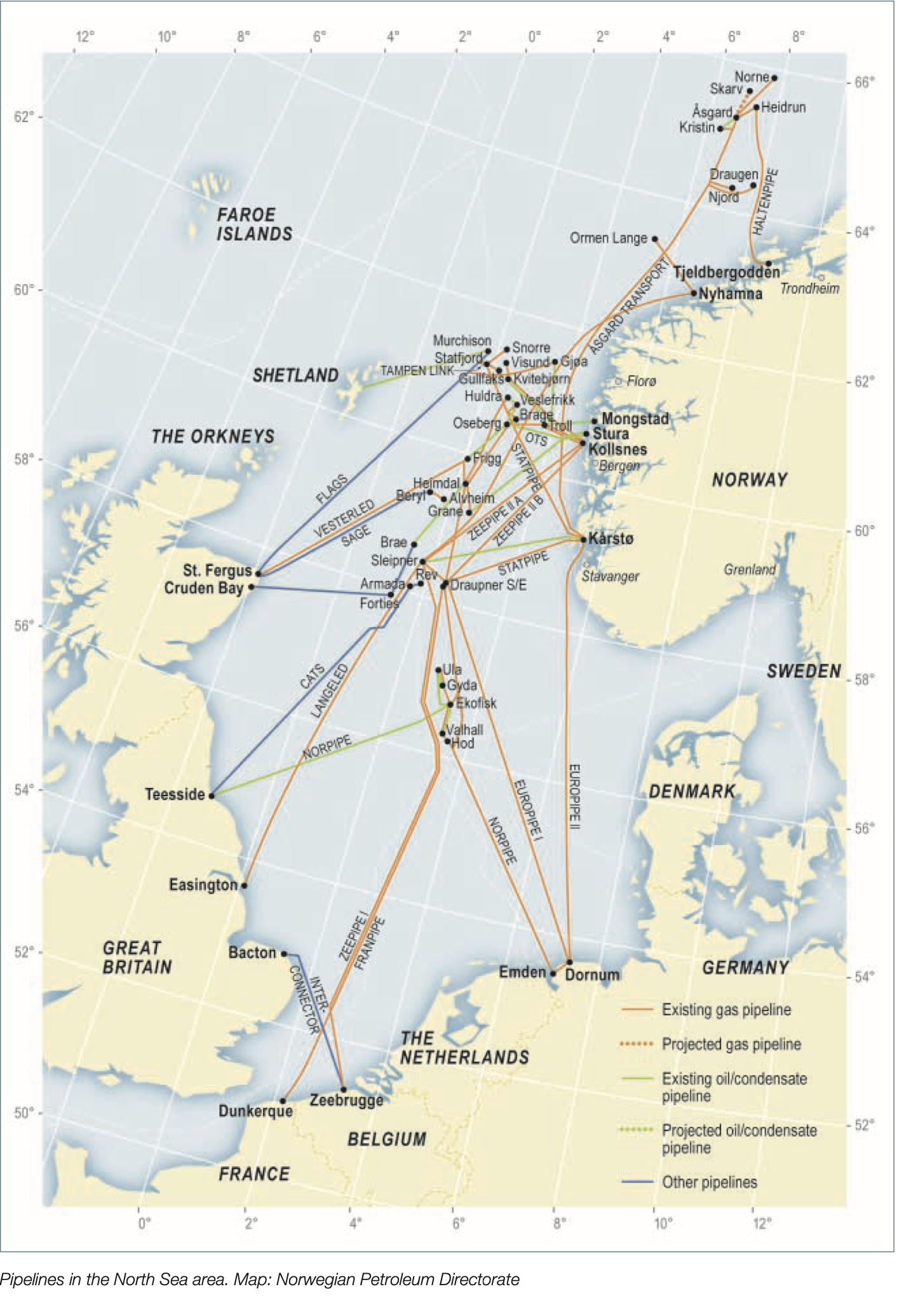

Extraction
The LCA begins with the Extraction of Oil and the primary source of oil, for the UK, is located at the north-sea. Those extracted oil is transported via pipeline system to the UK refinery station.
Assumption of Greenhouse Gas Emission data:
from Equinor Annual Report 2023 [2]
$6.7kg CO_{2}e$/$163kg$ $of oil extracted$
From Norsk Olje Museum [3]

Slide 8
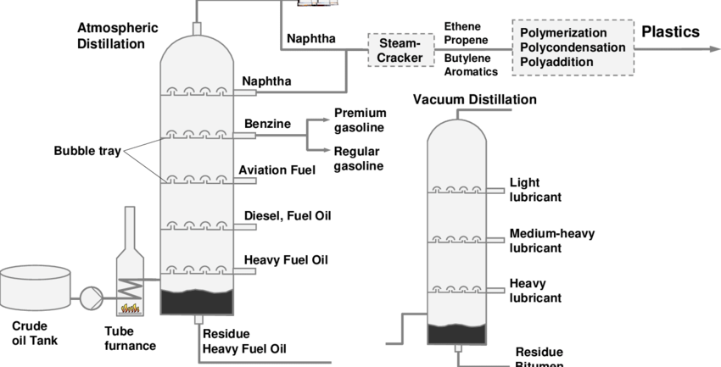
02
Production
Notes:
The next phase of LCA is the production of plastic resin from extracted raw material

Slide 9
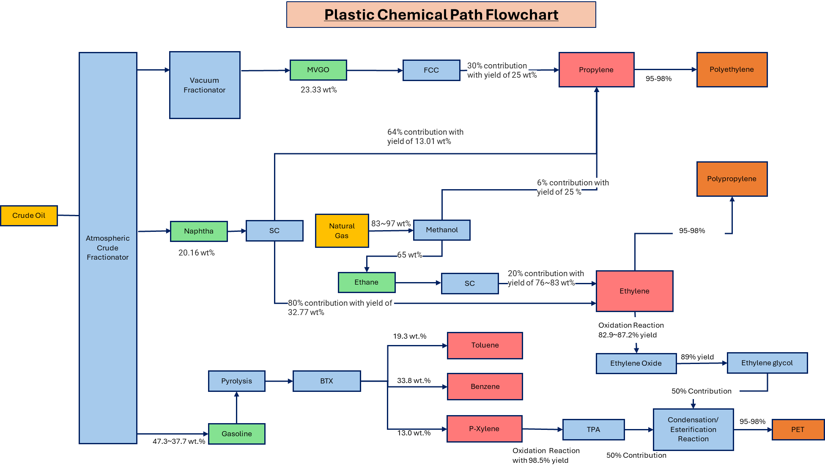
From Plastic Europe [4]
[4] Eco-profiles program and methodology PlasticsEurope ... (no date) Plastic Europe. Available at: https://plasticseurope.org/wp-content/uploads/2021/12/PlasticsEurope-Ecoprofiles-program-and-methodology_V3.0.pdf (Accessed: 05 June 2024).
Notes:
This flow chart encompasses all the chemical path required for the conversion of the extracted raw material tp each of the plastic resin within our study case which are PP, PE,polyethylene terephthalates. The reason why we have found the yield for each of the reaction is because this allows us to perform

Slide 10
Estimation of Raw Material
Methodology for estimation:
By finding all the chemical yields for each chemical reaction required to produce the plastic resin, we can estimate the amount of raw material required for each type of plastic within our case study which are PP, PE and PET.
Notes:
An estimation of the raw material required to produce 1 kg of plastic resin within our case study

Slide 11
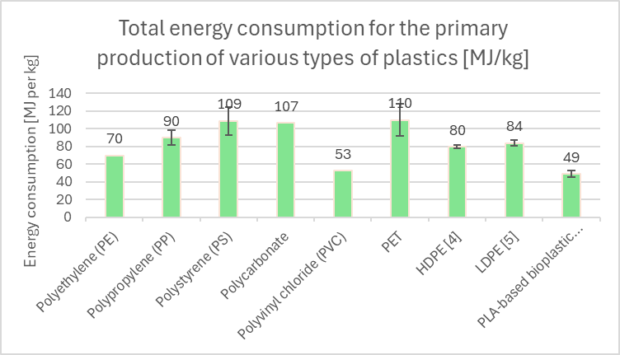
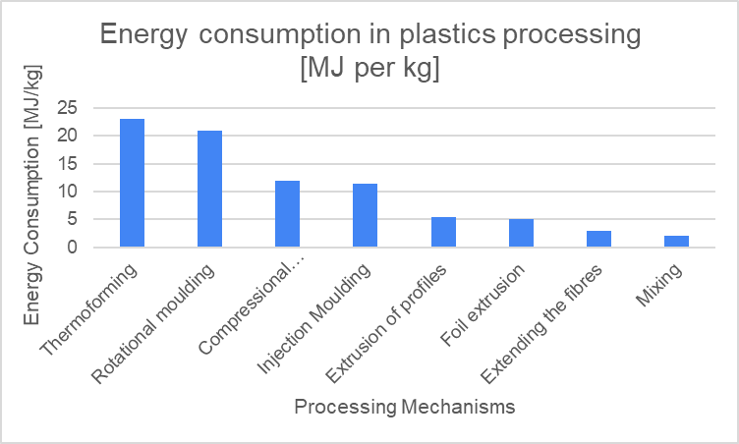

Energy consumption in fossil fuel extraction, primary resin production and plastic processing
Extraction and Resin production (Steam Cracking, Polymerisation, Oxidation, Esterification)
Plastic processing and product manufacturing (Moulding techniques)
From Journal of Ecological Engineering and CPME respectively [5],[6]
[2] Marczak, H. (2022). Energy Inputs on the Production of Plastic Products. Journal of Ecological Engineering, 23(9), 146–156.
[3] Polyethylene terephthalate (PET) (bottle grade). 2017. Committee of PET Manufacturers in Europe (CPME).
Notes:
As mentioned previously, Another important indicator we are interested in is the energy consumption. There are two graphes/ bar charts illustrating the relevant energy consumption during the production phase of plastic polymers and the manufacturing phase of the final products. The data are taken from these two organisations.
In Resin production phase, crude oil are converted into plastic resins via multiple yet different chemical processes (steam cracking, polymerisation, oxidation, esterification).
The four plastics that we are going to use in our case studies are: PP,PET,HDPE,LDPE
You can also see the errorbars plotted here, which is crudely derived by comparing results from different papers
The next is energy consumption in the Product manufacturing phase
It is obvious that we have different manufacturing mechanisms for making plastic products, E.g. when manufacturing plastic bottle caps, we use injection moulding, by injecting molten materials/plastics into a mould
such as thermoforming (transforming a plastic sheet into 3d-objects, injection moulding and etc)
The relevant processes we used in our case studies are highlightened in red boxes

Slide 12
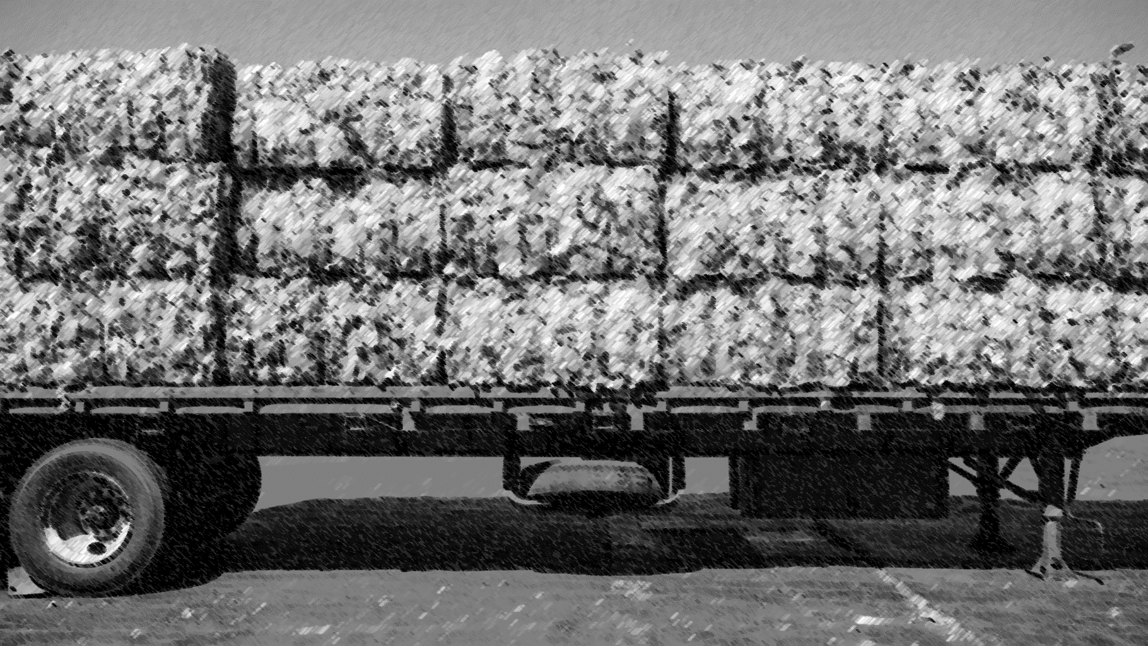
03
Transportation
Notes:
The next phase is transportation stage.

Slide 13
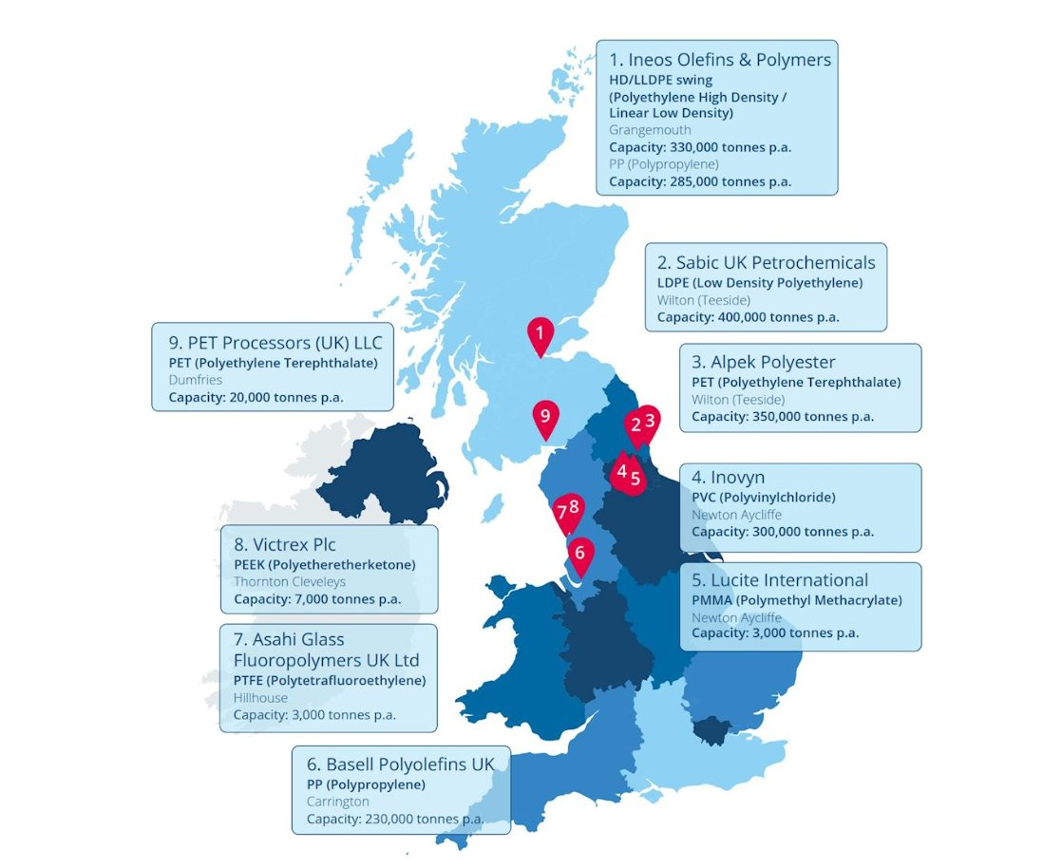
Supply Chain of Plastic Resin
We have based our plastic supply chain analysis by looking the largest plastic resin producer.
Since the refinery and the plastic resin plant are usually regionally based, we can predict which pipeline system is used for a particular plastic resin production. Hence estimate the transportation distance for different plastic resin production.
INEOS (uses forties pipeline system) and Alpek (uses norpipe system) [3]
[7]
[7] British Plastics Federation (2020) ”About the British Plastics Industry” [online], Available at: https://www.bpf.co.uk/industry/Default.aspx.
[3] Oil and gas fields in Norway, Norsk OljeMesuem, Available at: https://www.norskolje.museum.no/wp-content/uploads/2016/02/3467_5d1078cee8a64731bc1cf2bb04005f0e.pdf
Notes:
We have tackled this by analysing the plastic supply chain through the largest producer for each of the plastic resin in the UK. Since...

Slide 14
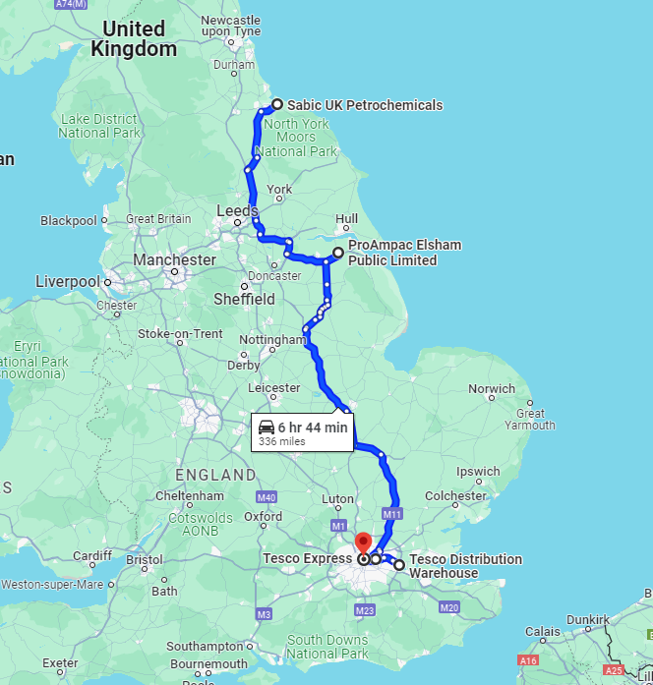
Plastic Distribution
From Sabic onwards plastic travels via HGV
On avg produce:
0.072 KgCO₂e per Km-Tonne
1008 KJ per Km-Tonne[4]
Location | Cumulative Distance [km]
Sabic Petrochemicals | 0
ProAmpac | 190
Greencore | 480
Tesco DC Dartford* | 498
Tesco Warren St.* | 525
*Indicates usage of refrigerated HGV emissions
Notes:
Plastic Resin's are produced at Sabic and from then are transported via diesel HGV's.
**Again all the points we've highlighted through this process are are ones that have been identified as the most reasonable for Tesco's to use**
They move down the country and are processed into plastic film, and assembled into a sandwich box at ProAmpac. These boxes are then transported to Greencore where sandwiches are packed into them.
The sandwiches then move through Tesco's distrubution network to stores.

Slide 15
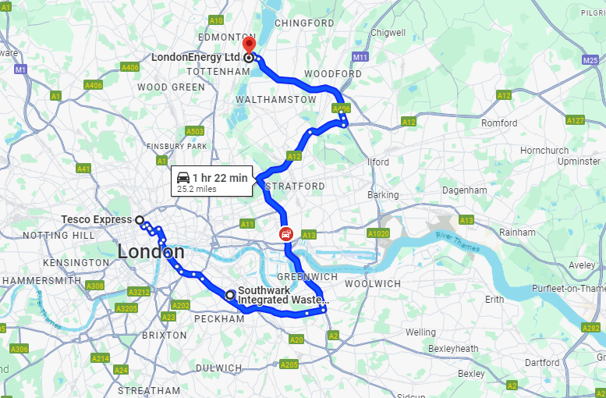
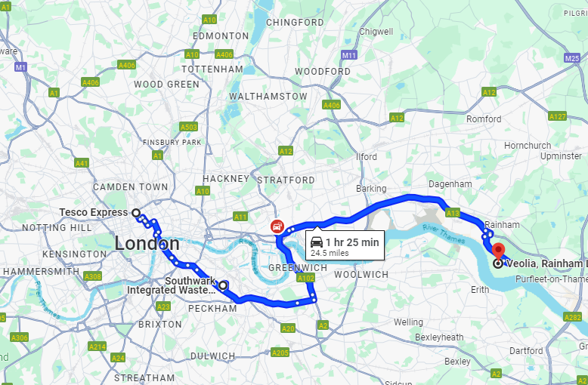
Transport to Waste Management
Central London Waste
10 Km
Veoila MRF Plant
27 Km
30 Km
Veolia Landfill Rainham
London EcoEnergy
Total from Transport | 0.7967 gCO₂e per package | 9.342kJ per package
Notes:
Considering the nature of meal deals, we made the assumption that they would be disposed on relatively near to location of purchase. So we then went about looking for the most convenient waste management locations to UCL. We found that the process that is most likely used is, waste sorting in an MRF facility in Southwark, before waste that cannot be recycled is most likely transported to a landfill in Rainham or an incinerator in Edmonton.
And below we have our total gCO2e and KJ in the distribution of one package

Slide 16

04
Waste Management
Note: Crude Oils are entirely negligible during this phase of LCA
Notes:
Fraction of a percent per metric tonne – becomes negligible

Slide 17
RECYCLING
Most common EOL process in UK -Department of Environment, Food and Rural Affairs (DEFRA) _{[8]}
Veolia Material Recycling and Recovery Facility in Southwark, London
Materials | Rate of Waste Recycled
Cardboard | 61%
Plastics (Unorganized) | 63%
PET | 70%
HDPE | 93%
Dense Plastics | 37%
Notes:
Using statistics from DEFRA, we found recycling to be the most common form of solid waste management internal to the UK.
We found how much household waste was produced a year, and how much of it was processed in an MRF, Incinerator or Landfill. From here we found individual rates of each material, these being the ones of interest in our study.
Unorganized Plastics, consisting of materials like PP and LDPE and Dense Plastics being things such as PETE and PVC

Slide 18
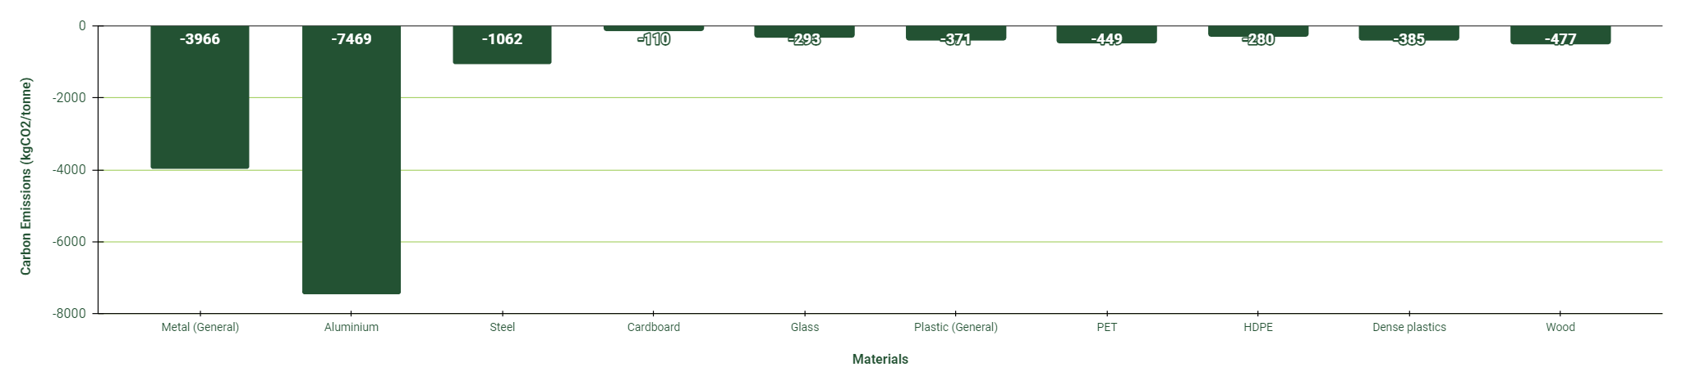
Carbon Emissions due to Recycling
Material | Emissions (kgCO2e/tonne)
Cardboard | -110
Plastics (Unorganized) | -371
PET | -449
HDPE | -280
Dense Plastics | -385
Units of kilograms of CO2 equivalent per tonne of waste
Due to sheer size of waste produced in the UK and given data. _{[9]}
Negative values represent removal of CO2 from the atmosphere!
Notes:
Here we have a graph of the carbon emissions due to recycling for each material type, given in kg of CO2 equivalent per tonne of waste, with the unit chosen is due to that being the standard measurement from DEFRA

Slide 19
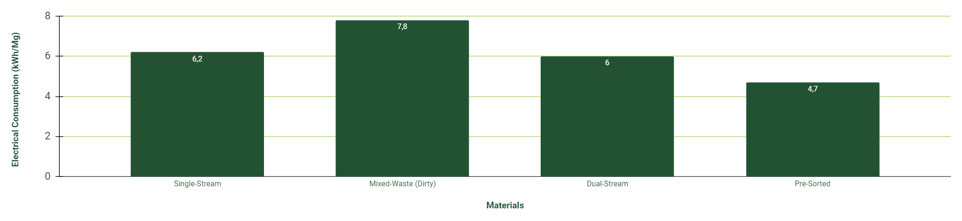
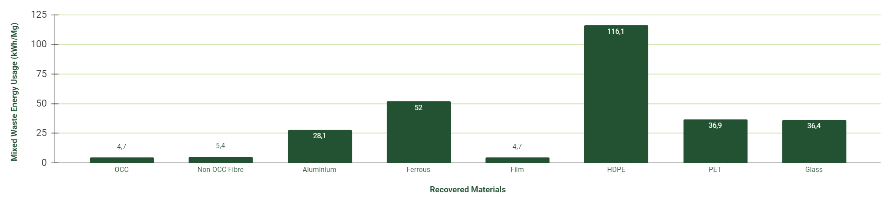
Energy Consumption due to Recycling
Due to Veolia using mixed-waste/dirty MRFs we can use the Solid Waste Optimization Life-Cycle Framework (SWOLF) _{[10]}:
Notes:
Next is energy consumption. For most complex unit waste processes, there is no industry-average data estimates, but there are MRF costs and energy consumption for the Solid Waste Optimization Life-Cycle Framework (SWOLF), so knowing Veolia is a mixed-waste MRF, we identified electrical usage for each recovered material in kilowatt hours per megagram (metric tonne).
- Different material names are given by SWOLF but OCC is cardboard and films being PP & LDPE

Slide 20

INCINERATION
Not entirely efficient!
Steam Cycle Combustion Incinerators (as used in our case study) are only 19-27% efficient! _{[11]}
London EcoPark in Edmonton, London
Material | Rate of Waste Incinerated
Cardboard | 34%
Plastics (Unorganized) | 31%
PET | 26%
HDPE | 6%
Dense Plastics | 55%
Notes:
Next is Incineration, being some combination of thermal treatment and power generation system in our case combustion and steam cycle, where the waste is incinerated and energy is produced. Following the same method we found the following rates.
We also found from Fichter’s Consulting Engineers, that WtE Plants are inefficient, with steam cycle combustion systems being 19-27% efficient, which will be factored in during energy consumption.

Slide 21
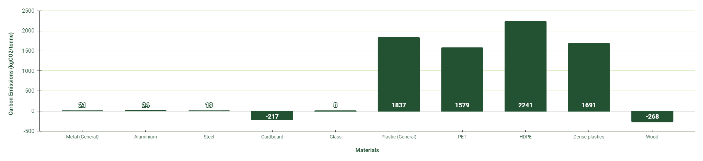
Carbon Emissions due to Waste-to-Energy
Material | Emissions (kgCO2e/tonne)
Cardboard | -217
Plastics (Unorganized) | 1837
PET | 1579
HDPE | 2241
Dense Plastics | 1691
From DEFRA – UK government department for Environmental, Food & Rural Affairs [9]
Notes:
Again, presented here are the carbon emissions in kgCO2 equivalent/tonne sorted by material, with our values of interest for the entire case study listed below

Slide 22
Energy Consumption during WtE
1.56kJ/g of CO2 mix in consumption
From IPCC research paper [12]
Notes:
From a carbon dioxide power plant mix instead of looking at individual materials, we can again see energy consumption. Due to that inefficiency of 19-27% stated prior, we see there is a huge waste. As such we found an energy consumption of around 1.56kJ/g

Slide 23
LANDFILL
Least used in the UK specifically in terms of household waste.
Large emissions mainly from cardboard and wood
Veolia Rainham Landfill
Material | Rate of Waste in Landfill
Cardboard | 5%
Plastics (Unorganized) | 6%
PET | 4%
HDPE | 1%
Dense Plastics | 9%
Notes:
Now with landfill, the least likely for our household waste, again our relevant rates shown.

Slide 24
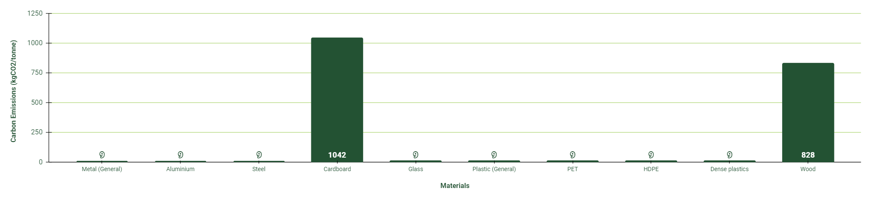
Carbon Emissions due to Landfill
Material | Emissions (kgCO2e/tonne)
Cardboard | 1042
Plastics (Unorganized) | 9
PET | 9
HDPE | 9
Dense Plastics | 9
From DEFRA – UK government department for Environmental, Food & Rural Affairs [9]
Notes:
Due to plastic’s resilience to decomposition, we see these incredibly low emissions, and then these much higher ones for the fibrous materials of cardboard and wood.

Slide 25
Energy Consumption in Landfill
Facility | Permitted Tonnage (per annum) | Electricity Output (MWe) | Site Scope (tonnes) | Electricity Generation (KJ/g)
Rainham | 1,500,000 | 16.7 | 140,000 | 1.2e^-7
From Veolia [13]
Such small energy generation/consumption, essentially negligible in case study
No material distinction within the landfill
If done so through percentage distributions, would find infinitesimally small generations
Notes:
And finally, using the released energy capacity of the Rainham facility as all materials are combined, we found that there was an incredibly small amount of energy produced due to the limited permitted tonnage per year and the tiny scope of the landfill.
As such we see that the electrical generation is essentially negligible in terms of our case study.
Due to our limited time, we previously used simple calculations for recovery energy, but we have a more specific model to better estimate the energy consumption for recovery.

Slide 26
06
Validation of energy consumption for recycling using model

Slide 27
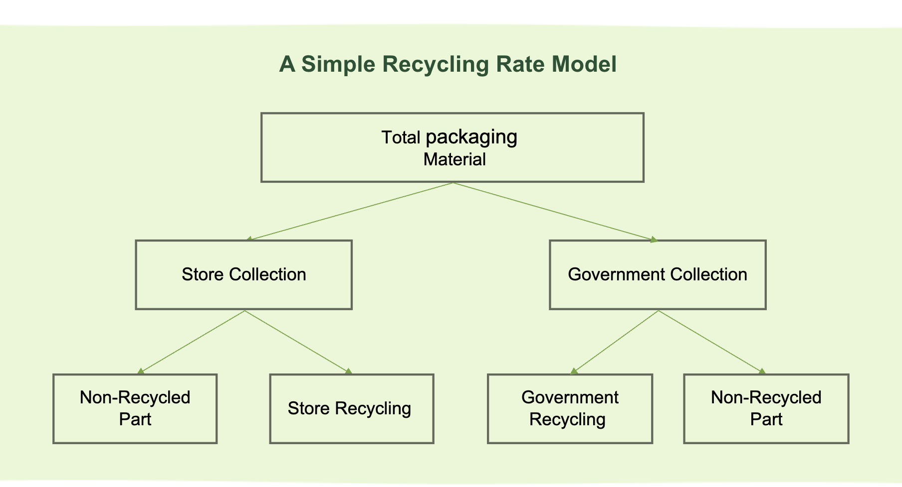
A Simple Recycling Rate Model
Total packaging
Material
Store Collection
Government Collection
Non-Recycled Part
Store Recycling
Government Recycling
Non-Recycled Part
Notes:
To calculate the recycling energy for Tesco's meal deal, we must establish a recycling rate model. We divided the total packaging handling into government collection and store collection. Store collection is further divided into store recycling and unrecycled parts, and we applied the same approach to government collection.

Slide 28
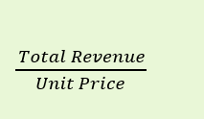
Total Packaging Material (2019)
Total Revenue: £167M
Unit Price: £3
Number of Meal deals Tesco sold across the UK =
[14]
Notes:
We found Tesco's meal deal revenue for 2019 and we can calculate the number of meal deals sold based on the unit price. We also know the packaging weight of the three products in the meal deal, so we can determine the total packaging weight generated by Tesco meal deals and the total weight of each material.

Slide 29
Total Recycling Rate (r)
Total store collection mass for plastics per year (include PET,PP,LDPE,HDPE)
2. Total store collection mass for cardboard per year
3. Total mass of all plastic packaging
4. Total mass of cardboard packaging
5. The recycling rate of store collection
6. The recycling rate of government for plastic and cardboard
Notes:
According to our model, to calculate the total disposal energy, we need to compute the total recycling rate for cardboard and plastics. These are the six quantities needed to calculate the recycling rate.

Slide 30
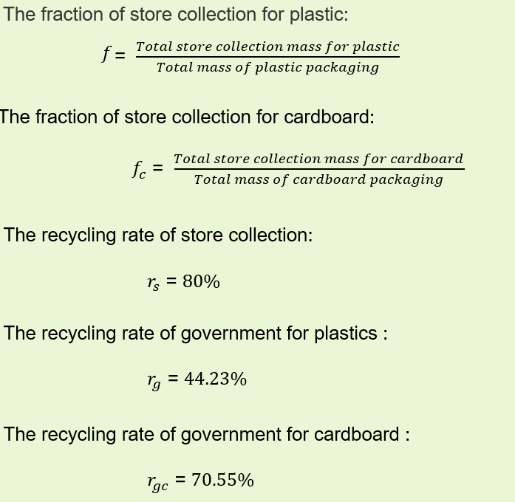
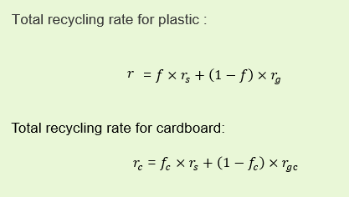
[15],[18]
Notes:
The quantities expressed with formulas are those we calculated based on our model and research data. The quantities expressed with numbers are those we found in literature or on websites that can be used.

Slide 31
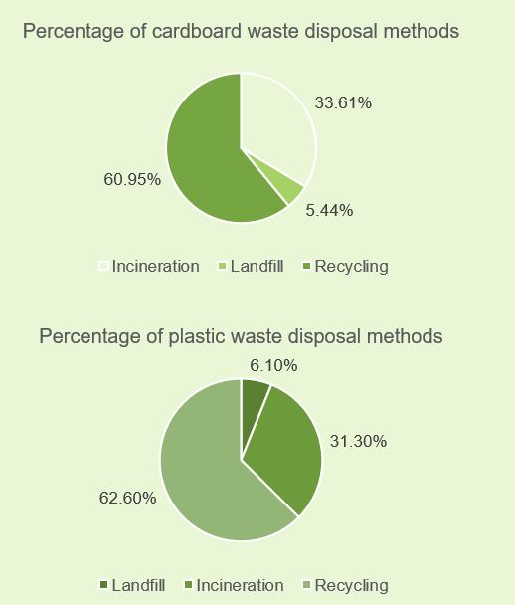
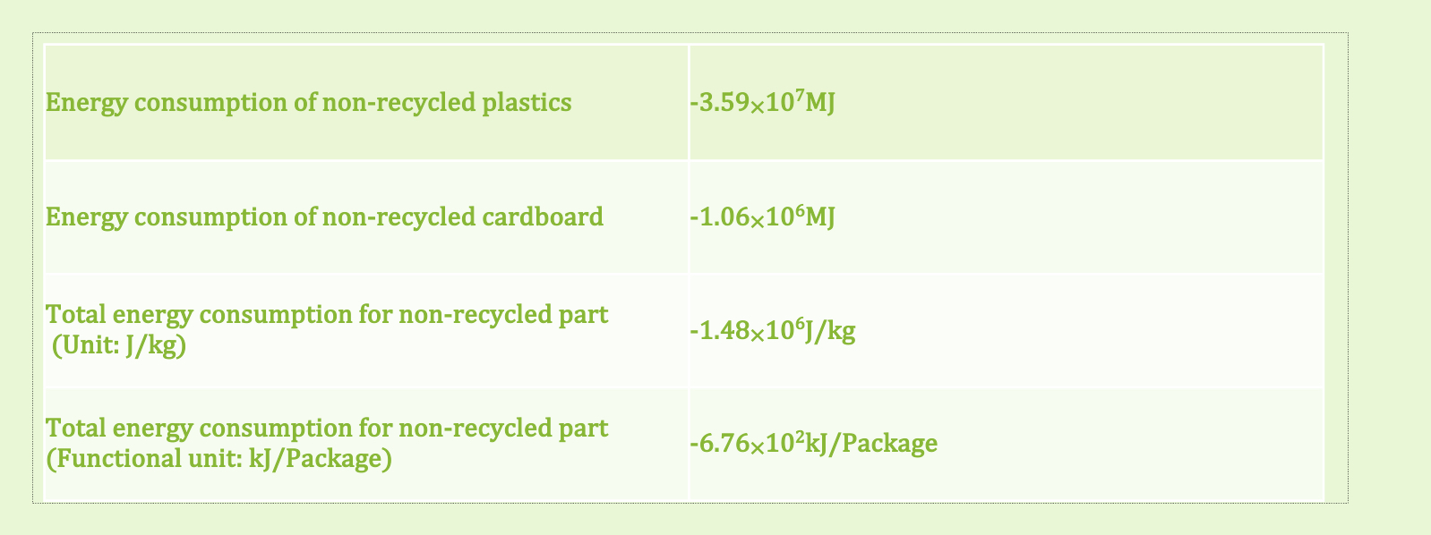
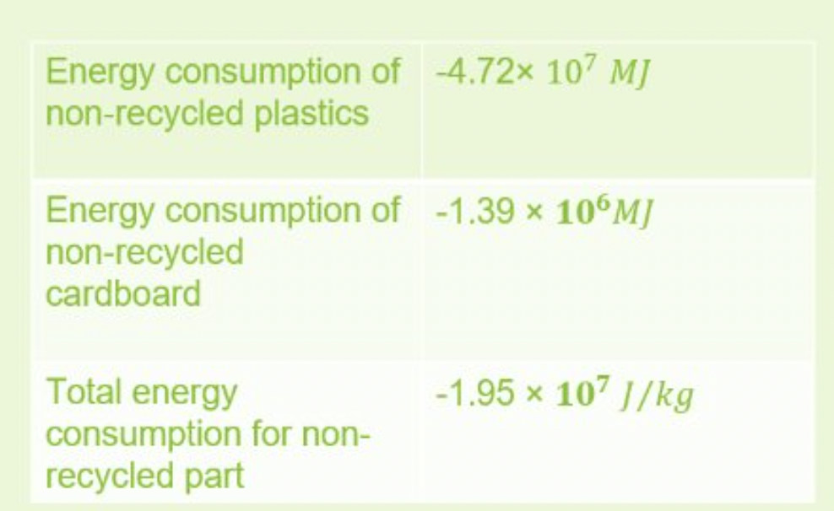
Total Disposal Energy Consumption​
(Non-Recycled Part)​
Negative value: Incineration exothermic
[15],[16],[18]
Two paths to be considered: Landfill and incineration
Notes:
We divided the total disposal energy consumption into a non-recycled part and a recycled part. In the non-recycled part, we only consider the energy consumed during landfill and incineration of cardboard and plastic. The result is negative because incineration releases heat.

Slide 32
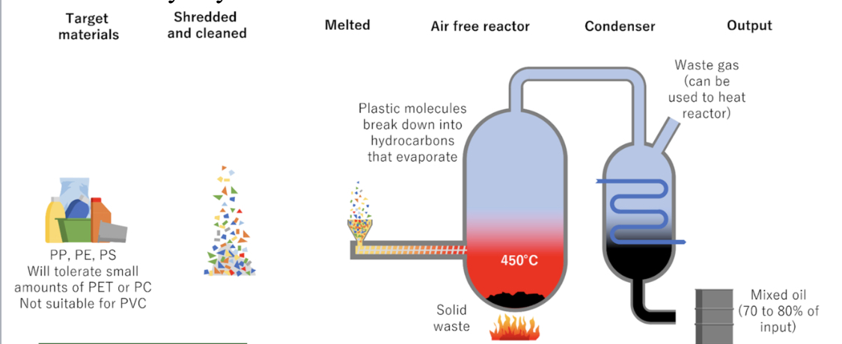
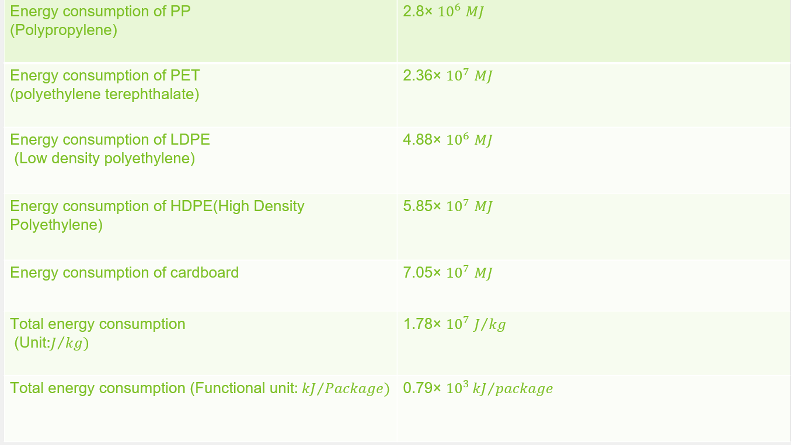
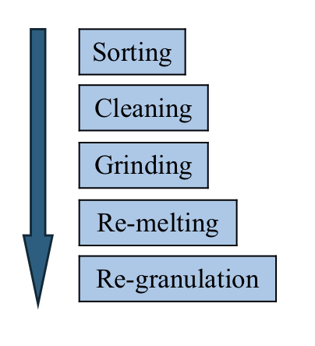
Total Disposal Energy Consumption
(Recycled Part)
Chemical recycling for PP
Mechanical recycling for thermoplastic
[15],[16],[18],[19]
Notes:
In the recycled part, we also considered the energy consumed by mechanical recycling and chemical recycling.

Slide 33
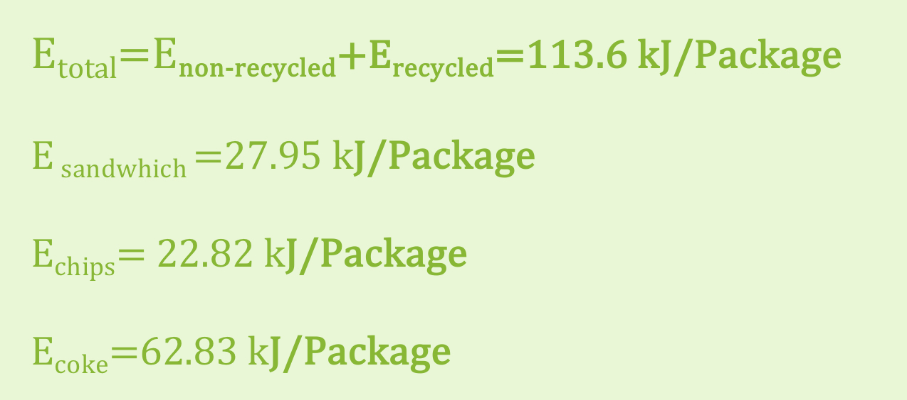
Total Disposal Energy Consumption (Recycled Part and non-recycled part)
(Error Percentage: For coke 18.87%​)
​
Notes:
This is the energy consumption we calculated for the entire recycling process, as well as the energy consumption for the functional unit of each of the three products: sandwich, chips, and cola. Comparing these with pre-model data, we found that the recycling energy for cola matches well. With this comparison, we can see the more specific recycling model gives us better estimation of the disposal energy consumption. This validate our previous energy value used for the LCA energy recycling computation.

Slide 34
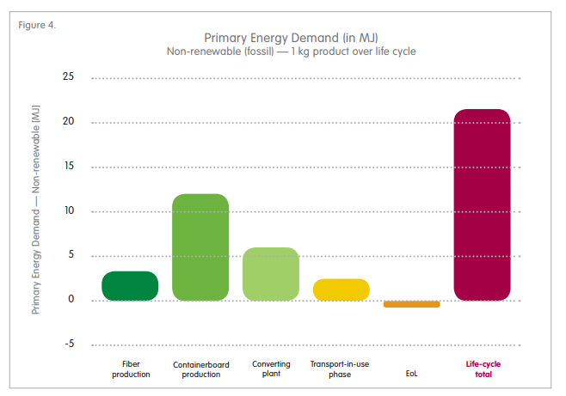
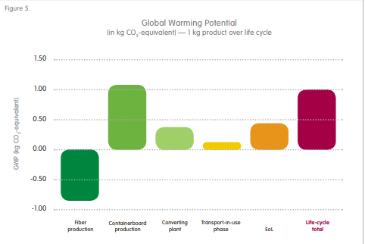
Cardboard LCA analysis: Energy consumption and GHG emissions
System Boundaries (Unit processes that are considered):
Fibre extraction
Pulp and papermaking operations (chipping, pulping and chemical bleaching)
Converting (e.g. the linerboard and corrugating medium into food packaging.)
Transportation (extraction point – Paper mill – manufacturing facilities – distribution – retailing – EoL)
End-of-life management (incineration, landfill, recycle)
[4] PE-Americas and Five Winds International, Corrugated Packaging Life-cycle Assessment Summary Report, Available at: https://www.eco conception.fr/data/sources/users/306/docs/corrugated-packaging-life-cycle-assessment.pdf
From PE-Americas and Five Winds International.
Notes:
Just like the LCA of plastics, we conducted a similar but simplified assessment on the energy consumption and GHG emissions applicable to the lifecycle of cardboards which are used in our sandwich packaging. The data are taken from a researched report and are plotted here. It is interesting to note that we have a negative co2 emissions for fibre production, this is because we using biomass instead of fossil fuels.

Slide 35
07
Results and Findings
Notes:
So Onto our findings. First of all we have a total Crude Oil Consumption per package. We can see out of the meal deal the coke bottle uses by far the most natural resources. And this trend continues…

Slide 36
Results and Findings
97.68%
99.35%
96.15%
Notes:
Yet again we see Coke as the most detrimental item.
In this case, as we’ve considered Energy and CO2 emissions in all 3 stages, we’ve decided to break down the emissions into their sperate stages, so that we can analyse the damage caused by each stage in the process. An important thing to note here is that the production stage makes up a very large part of the total energy consumption.
We can also do the same for emissions

Slide 37
Results and Findings
93.00%
75.55%
99.19%
Notes:
Again for total emissions, the coke bottle is the worst polluter out of the three.
From this we can make the firm recommendation, that if a producer wishes to reduced their carbon footprint, the only viable way to do so is to reduce their production emissions

Slide 38
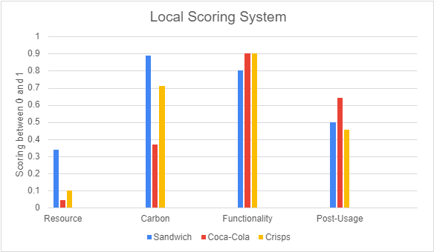
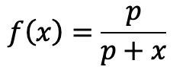
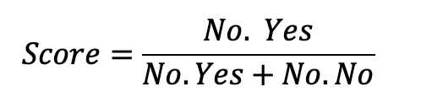
Local Scoring System
4 Category of Scoring [2]: Resource Footprint Scoring, Carbon Footprint Scoring, Functionality Scoring and Post-Usage Scoring
Methodology
Resource Footprint Scoring is computed from the absolute resource footprint [21] (the value of x in equation 1) of the packaging.
Similarly, Carbon Footprint is computed using equation 1 with x being the carbon footprint of the packaging (from LCA)
Functionality Scoring and Post-Usage Scoring are individually based on a series of criterion related to shelf-life and post-usage fate respectively and this is translated to a series of questions with a binary Answer. The scoring is ratio between the number of “Yes” Answer and the number of questions (equation 2).
Equation 1 [22]
Equation 2 [22]

Slide 39
Aggregated Performance Scoring
An aggregated performance scoring [7] is only possible if we evaluate the local scoring for different packaging material for food type. The methodology used to obtain the aggregated performance score is called voting rule which input the local ranking of scores between different packaging material for the food type and output a single global ranking of score.
We could therefore use this single global ranking of score as a basis to make informed-decision about the optimal solution to minimise the environmental impact of a packaging for a specific food type.

Slide 40
08
Further Improvements

Slide 41
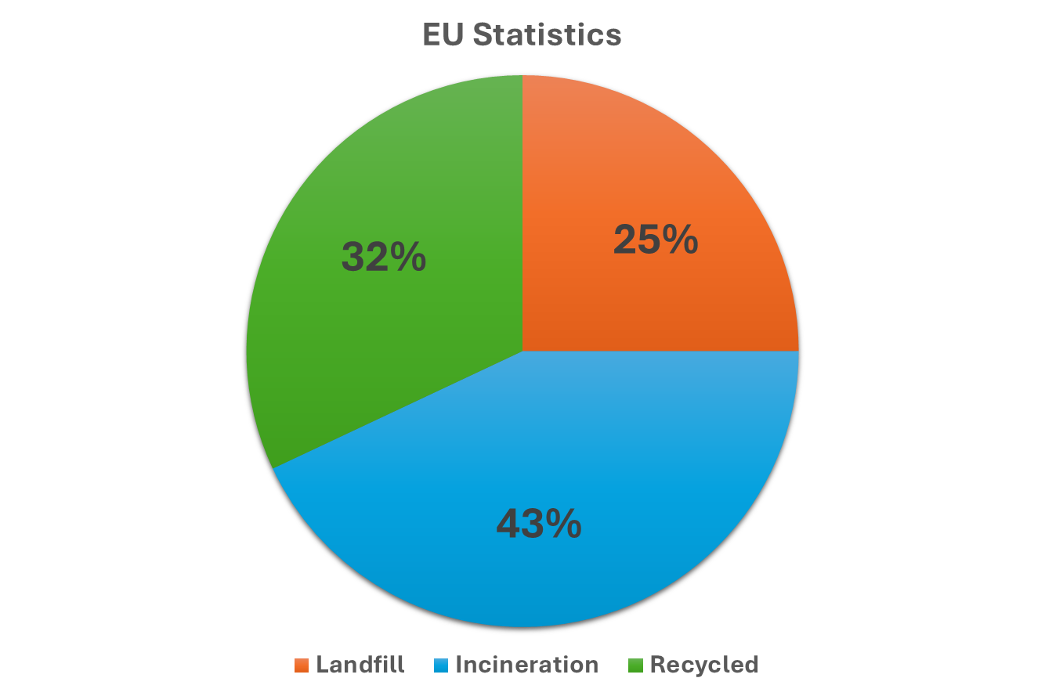


New Recycling Model
* Model Expansion [23,24]
Hydrolysis
Mechanical
Solvolysis
Glycolysis
Methanolysis
Pyrolysis
Recycling
Chemical
Gasification
Thermal
Dissolution
HydroThermal Treatment
Incineration
We are adding new branches of possible recycling routes for plastics in the UK and EU to the existing model recycling routes for plastics in the UK and EU.
The weighting for each route was calculated using general statistics found in research papers and consulting companies' reports.
The possible limitations for the extended model are due to the quality and quantity of published open-source results from recycling plants around the UK and EU.
Landfill
[23] [24] [25]
[25]
Notes:
British Plastics Federation (BPF) -> is the leading trade association for the UK plastics industry.
Independent Comodity Intelligence Services (ICIS) -> is a global leader in providing market intelligence for the energy and chemical sectors

Slide 42
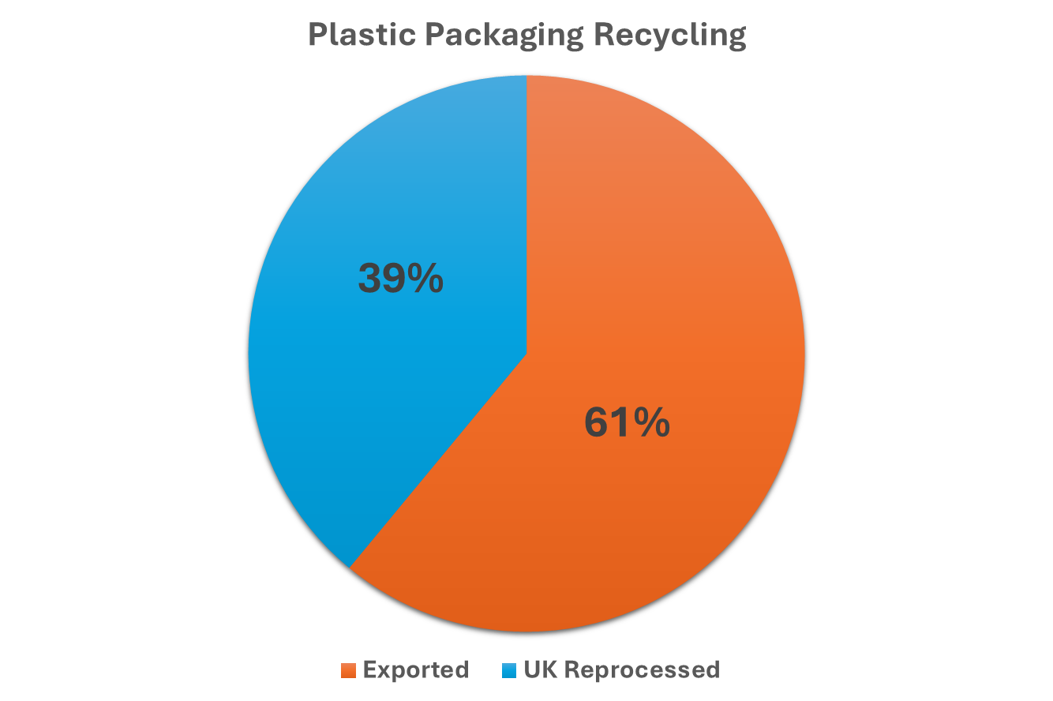
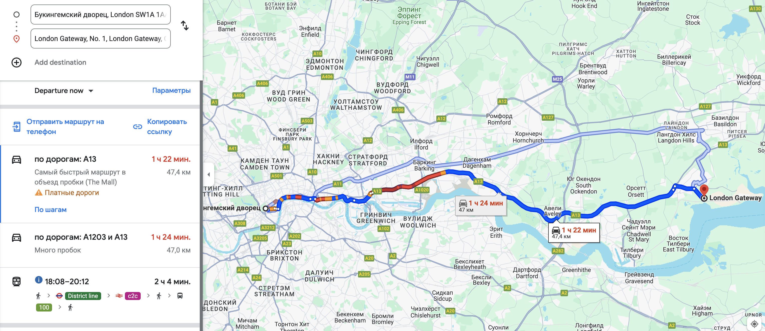

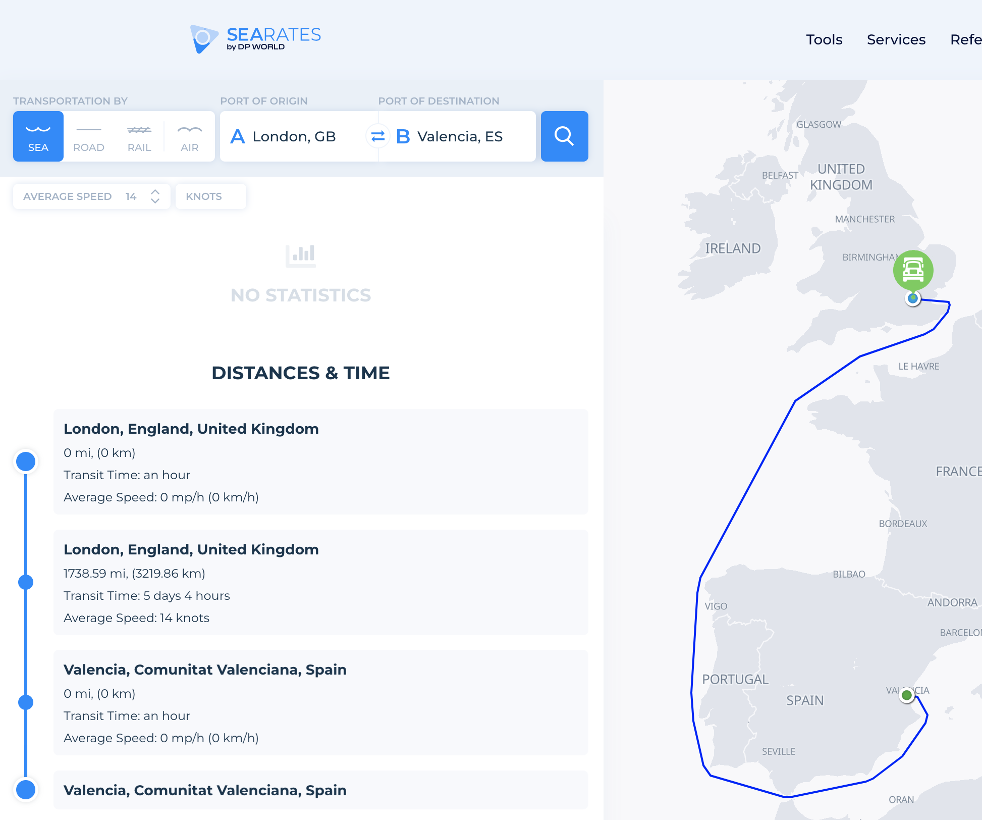
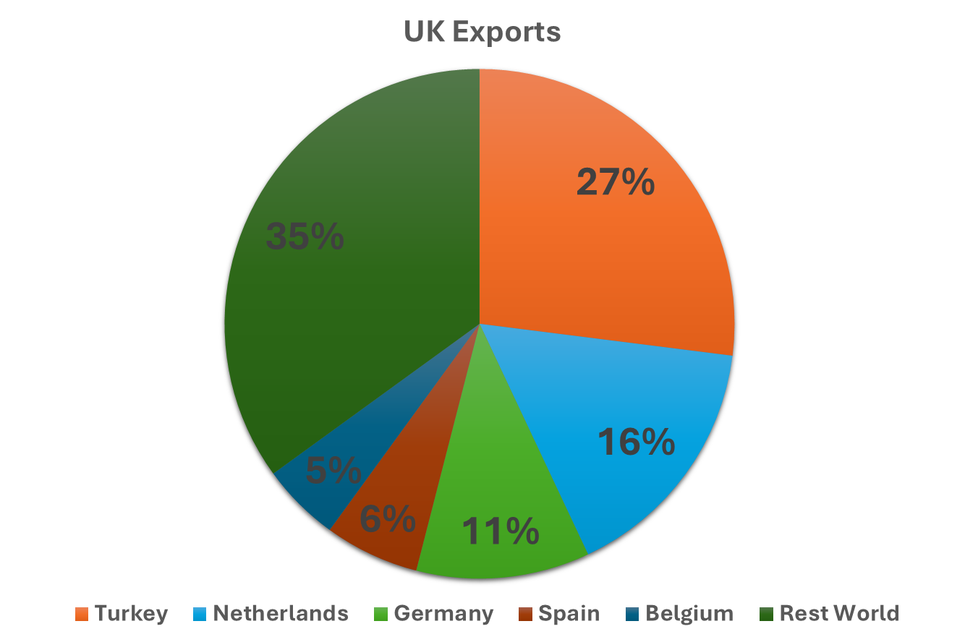




New Waste Management Transport Model
[12]
​PET ​
GHG ↑850%
Energy ↑660%
​HDPE ​
[13]
[14]
GHG ↑17%
Energy ↑10%
​LDPE ​
GHG ↑420%
Energy ↑390%
[26] https://www.enfplastic.com/directory/plant
[27] https://www.searates.com/services/distances-time
[28] https://www.bpf.co.uk/roadmap
Notes:
SEARATES -> is an online platform that connects shippers with freight forwarders to get the best rates and manage cargo shipments. It functions like a marketplace where you can compare rates, book shipments, and track your cargo across land, sea, and air. They also offer tools to help freight forwarders manage their business more efficiently.
Plastic Recycling Business Directory (ENF) -> ENF Recycling is a free online directory that connects businesses and individuals with plastic recycling companies around the world. They list over 10,200 plastic recycling companies along with their contact information and capabilities. In addition to the directory, ENF Recycling also provides information on plastic recycling equipment, including different types of machines used in the process.

Slide 43
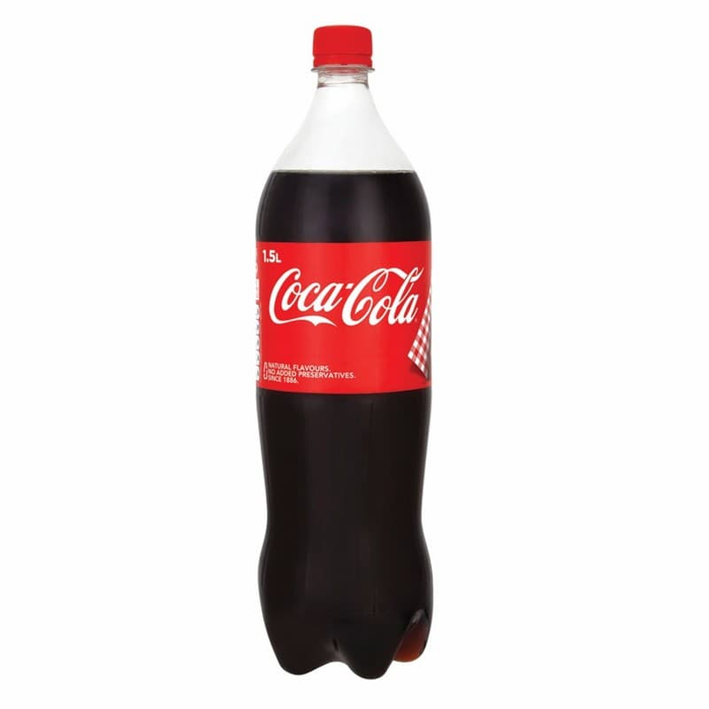

Scenario 1
Scenario 2
Models Predictions on Coca-Cola Recycling Case Study
Scenario 1 – Using the general statistics of EU recycling
Scenario 2 - Adjusting weights of the recycling routes for material using Coca-Cola sustainability report
​PET ​
​PET ​
GHG ↑2200%
GHG ↑370%
Energy ↑14,600%
Energy ↑6,000%
​ Overall
​HDPE ​
​HDPE ​
GHG ↑330%
GHG ↑580%
GHG ↑652%
Energy ↑2,700%
Energy ↑160%
Energy ↑1,100%
​ Total LCA
​LDPE ​
​LDPE ​
GHG ↑15%
GHG ↑220%
GHG ↑220%
Energy ↓63%
Energy ↓ 63%
Energy ↑6%

Slide 44
198
Models Results Comparing Coca-Cola LCA
​ Data Generated
​ Official Data
Deviation
[15]
18%
GHG / gCO2eq/Bottle
240*
3650
N/A
N/A
Energy / KJ / Bottle
*Data used from LCA coca-cola sustainability report
[30]

Slide 45
References:
[1] T. Theis, J. Tomkin, “Sustainability: A Comprehensive Foundation.”,2018 12th Media Services, 2018.
[2] Equinor, “Integrated Annual Report” [online], 2023, Available: https://cdn.equinor.com/files/h61q9gi9/global/76629806e2cc50eefdd89d5b8daabda39247db63.pdf?2023-annual-report-equinor.pdf
[3] Harald Tønnesen, “Oil and Gas fields in Norway. Industrial Heritage plan”, Norwegian Petroleum Museum, 2011, Available at: https://www.norskolje.museum.no/wp-content/uploads/2016/02/3467_5d1078cee8a64731bc1cf2bb04005f0e.pdf (Accessed: 05 June 2024) [4] Plastic Europe. “Eco-profiles program and methodology” [online], 2019, Available at: https://plasticseurope.org/wp-content/uploads/2021/12/PlasticsEurope-Ecoprofiles-program-and-methodology_V3.0.pdf (Accessed: 05 June 2024)
[5] Marczak, H., “Energy Inputs on the Production of Plastic Products.”, 2022, Journal of Ecological Engineering, 23(9), p.g 146–156.
[6] Polyethylene terephthalate (PET) (bottle grade). 2017. Committee of PET Manufacturers in Europe (CPME).
[7] British Plastics Federation, ”About the British Plastics Industry” [online], 2020, Available at: https://www.bpf.co.uk/industry/Default.aspx (Accessed: 05 June 2024)
[8] DEFRA, “UK statistics on waste”, 2023, GOV.UK, Available at: www.gov.uk/government/statistics/uk-waste-data/uk-statistics-on-waste
[9] DEFRA, “Experimental Statistics on the carbon impact of waste from households managed by local authorities in England”, 2022, GOV.UK, page. 21-22
[10] Pressley, P., James Levis, Anders Damgaard, Morton Barlaz, Joseph DeCarolis, “Analysis of material recovery facilities for use in life-cycle assessment”, 2024, PubMed, Waste Management, 1-8, DOI: 10.1016/j.wasman.2014.09
[11] Fichtner Consulting Engineers Limited , “The Viability of Advanced Thermal Treatment in the UK”, March 2004, ESTET, p.g 25
[12] Johnke B., “Emissions from Waste Incineration”, 2002, Available at:https://www.ipcc-nggip.iges.or.jp/public/gp/bgp/5_3_Waste_Incineration.pdf8
[13] Veolia (2024) Veolia Landfill Sites, Available at: http://www.veolia.co.uk/veolia-united-kingdom-landfill-sites

Slide 46
References:
[14] A. Egan, ‘Tesco meal deal price increase: Inflation, up close’, Tedium: The Dull Side of the Internet. [Online]. Available: https://tedium.co/2022/03/11/tesco-meal-deal-price-increase-analysis/. [Accessed: 06-Jun-2024].
[15] Tescoplc.com. [Online]. Available: https://www.tescoplc.com/soft-plastics-collected-at-tesco-to-become-bin-liners-in-new-recycling-solution/. [Accessed: 06-Jun-2024].
[16] Uses Class and Embodied Processing Recycling Embodied Processing Recycling, ‘DATABANK OF MATERIAL DATA’, Cam.ac.uk. [Online]. Available: http://www-materials.eng.cam.ac.uk/energyforschools/downloads/Materials+databank.pdf. [Accessed: 06-Jun-2024].
[17] Plasticenergy.com. [Online]. Available: https://plasticenergy.com/wp-content/uploads/2020/10/Plastic-Energy-LCA-Executive-Summary.pdf. [Accessed: 06-Jun-2024].
[18] G. Ingarao, S. Licata, M. Sciortino, D. Planeta, R. Di Lorenzo, and L. Fratini, ‘Life cycle energy and CO2 emissions analysis of food packaging: an insight into the methodology from an Italian perspective’, Int. J. Sustain. Eng., vol. 10, no. 1, pp. 31–43, 2017.
[19] J. Morris, ‘Recycling versus incineration: an energy conservation analysis’, J. Hazard. Mater., vol. 47, no. 1–3, pp. 277–293, 1996.
[20] Com.au. [Online]. Available: https://pipa.com.au/wp-content/uploads/2021/05/ESTIMA1.pdf. [Accessed: 06-Jun-2024].

Slide 47
References:
[21] Chararalampos Michalakakis, J. Fouillou, R. C. Lupton, A. Hernandez, and J. M. Cullen, “Calculating the chemical exergy of materials,” Journal of Industrial Ecology, vol. 25, no. 2, pp. 274–287, Apr. 2021, doi: https://doi.org/10.1111/jiec.13120.​
[22] Frojan J, Bisquert P, Buche P, et al. Scoring methodology for comparing the environmental performance of food packaging. Packag Technol Sci. 2023; 36(6): 439-463. doi:10.1002/pts.2720
[23] “Plastic recycling”, 2018, Available at: https://www.bpf.co.uk/Sustainability/Plastics_Recycling.aspx
[24] ICIS, “Propylene”, Available at: https://www.icis.com/explore/commodities/chemicals/polypropylene/?intcmp=commodities-mixed-plastic-waste_pp (Accessed: 05 June 2024)
[25] ”Recent Advancements in Plastic Packaging Recycling: A Mini-Review”, 24 August 2021, MDPI, material 2021, 14(17), 4782; Available at: https://doi.org/10.3390/ma14174782
[26] ”Plastic Recycling Plants Directory”, ENF, Available at: https://www.enfplastic.com/directory/plant (Accessed: 05 June 2024)
[27] https://www.searates.com/services/distances-time (Sorry I have no idea how to cite this, I am afraid)
[28] ”Recycling Roadmap”, BPF, Available at: https://www.bpf.co.uk/roadmap (Accessed: 05 June 2024)
[29] https://www.tru.ca/__shared/assets/trubeveragecontainerreview30336.pdf
[30] Thomas H.Owen, Kaitlin Boyd, “Beverage Container Review”, July 2023, Thompson Rivers University, Office of Environmental & Sustainability, p.g. 17

